Slide 1
ARTIFICIAL INTELLIGENCE

Slide 2
UNIT: 1 WHAT IS AI?

Slide 3
WHAT IS AI?
Artificial intelligence is the study of how to make computers do things which, at moment people do better.
Artificial intelligence can be viewed from a variety of perspectives.
From the perspective of intelligence, artificial intelligence is making machines "intelligent" -- acting as we would expect people to act.
The inability to distinguish computer responses from human responses is called the Turing test.
Intelligence requires knowledge.

Slide 4
WHAT IS AI?
From a business perspective AI is a set of very powerful tools, and methodologies for using those tools to solve business problems.
From a programming perspective, AI includes the study of symbolic programming, problem solving, and search.
Typically AI programs focus on symbols rather than numeric processing.
Problem solving i.e. to achieve a specific goal.
Search - rarely access a solution directly. Search may include a variety of techniques.
It is the science and engineering of making intelligent machines, especially intelligent computer programs.

Slide 5
AI Problems
Much of the early work in the field of AI focused on formal tasks, such as game playing and theorem proving.
Game playing and theorem proving share the property that people who do them well are considered to be displaying Intelligence.
Initially computers could perform well at those tasks simply by being fast at exploring a large number of solution paths and then selecting the best one.
Humans learn mundane (ordinary) tasks since their birth. They learn by perception, speaking, using language, and training. They learn Formal Tasks and Expert Tasks later.
Another early foray into AI focused on commonsense reasoning, which includes reasoning about physical objects and their relationship to each other, as well as reasoning about actions and their consequences.

Slide 6
AI Problems
As AI research progressed, techniques for handling large amount of world knowledge were developed.
New tasks reasonably attempted such as perception, natural language understanding and problem solving in specialized domains.
Some of the task domains of artificial intelligence are presented in table I.
Earlier, all work of AI was concentrated in the mundane task domain.

Slide 7
AI Problems
Later, it turned out that the machine requires more knowledge, complex knowledge representation, and complicated algorithms for handling mundane tasks.
This is the reason why AI work is more flourishing in the Expert Tasks domain now, as the expert task domain needs expert knowledge without common sense, which can be easier to represent and handle.
Mundane tasks | Formal tasks | Expert tasks
Perception Computer Vision Speech, Voice | Games Go Chess (Deep Blue) Ckeckers | Engineering Design Fault Finding Manufacturing Monitoring
Natural Language Processing Understanding Language Generation Language Translation | Mathematics Geometry Logic Integration and Differentiation | Scientific Analysis
Common Sense Reasoning | Theorem Proving | Financial Analysis
Planning |  | Medical Diagnosis
Robot Control
TASK DOMAINS OF AI

Slide 8
What is an AI technique?
Artificial intelligence problems span a very broad spectrum. They appear to have very little in common except that they are hard.
AI Research of earlier decades results into the fact that intelligence requires knowledge.
Knowledge possess following properties:
O It is voluminous.
O It is not well-organized or well-formatted.
O It is constantly changing.
O It differs from data. And it is organized in a way that corresponds to its usage.

Slide 9
What is an AI technique?
AI technique is a method that exploits knowledge that should be represented in such a way that:
O Knowledge captures generalization. Situations that share common properties are grouped together. Without this property, inordinate amount of memory and modifications will be required.
O It can be understood by people who must provide it. Although bulk of data can be acquired automatically, in many AI domains most of the knowledge must ultimately be provided by people in terms they understand.
O It can easily be modified to correct errors and to reflect changes in the world.
O It can be used in many situations even though it may not be totally accurate or complete.
O It can be used to reduce its own volume by narrowing range of possibilities.

Slide 10
What is an AI technique?
There are three important AI techniques:
1. Search –
a. Provides a way of solving problems for which no direct approach is available.
b. It also provides a framework into which any direct techniques that are available can be embedded.
2.Use of knowledge –
a.Provides a way of solving complex problems by exploiting the structure of the objects that are involved.
3. Abstraction –
a. Provides a way of separating important features and variations from many unimportant ones that would otherwise overwhelm any process.

Slide 11
Classification of AI
Weak AI:
The study and design of machines that perform intelligent tasks.
Not concerned with how tasks are performed, mostly concerned with performance and efficiency, such as solutions that are reasonable for NP-Complete problems. E.g., to make a flying machine, use logic and physics, don’t mimic a bird.
Strong AI:
The study and design of machines that simulate the human mind to perform intelligent tasks.
Borrow many ideas from psychology, neuroscience. Goal is to perform tasks the way a human might do them – which makes sense, since we do have models of human thought and problem solving.
Includes psychological ideas in STM, LTM, forgetting, language, genetics, etc. Assumes that the physical symbol hypothesis holds.
Evolutionary AI: The study and design of machines that simulate simple creatures, and attempt to evolve and have higher level emergent behavior. For example, ants, bees, etc.

Slide 12
Applications of AI
AI has been dominant in various fields such as −
Gaming − AI plays vital role in strategic games such as chess, poker, tic-tac-toe, etc., where machine can think of large number of possible positions based on heuristic knowledge.
Natural Language Processing − It is possible to interact with the computer that understands natural language spoken by humans.
Expert Systems − There are some applications which integrate machine, software, and special information to impart reasoning and advising. They provide explanation and advice to the users.
Computer Vision Systems − These systems understand, interpret, and comprehend visual input on the computer.

Slide 13
Applications of AI
Speech Recognition − Some intelligent systems are capable of hearing and comprehending the language in terms of sentences and their meanings while a human talks to it. It can handle different accents, slang words, noise in the background, change in human’s noise, etc.
Handwriting Recognition − The handwriting recognition software reads the text written on paper by a pen or on screen by a stylus. It can recognize the shapes of the letters and convert it into editable text.
Intelligent Robots − Robots are able to perform the tasks given by a human. They have sensors to detect physical data from the real world such as light, heat, temperature, movement, sound, bump, and pressure. They have efficient processors, multiple sensors and huge memory, to exhibit intelligence. In addition, they are capable of learning from their mistakes and they can adapt to the new environment.

Slide 14
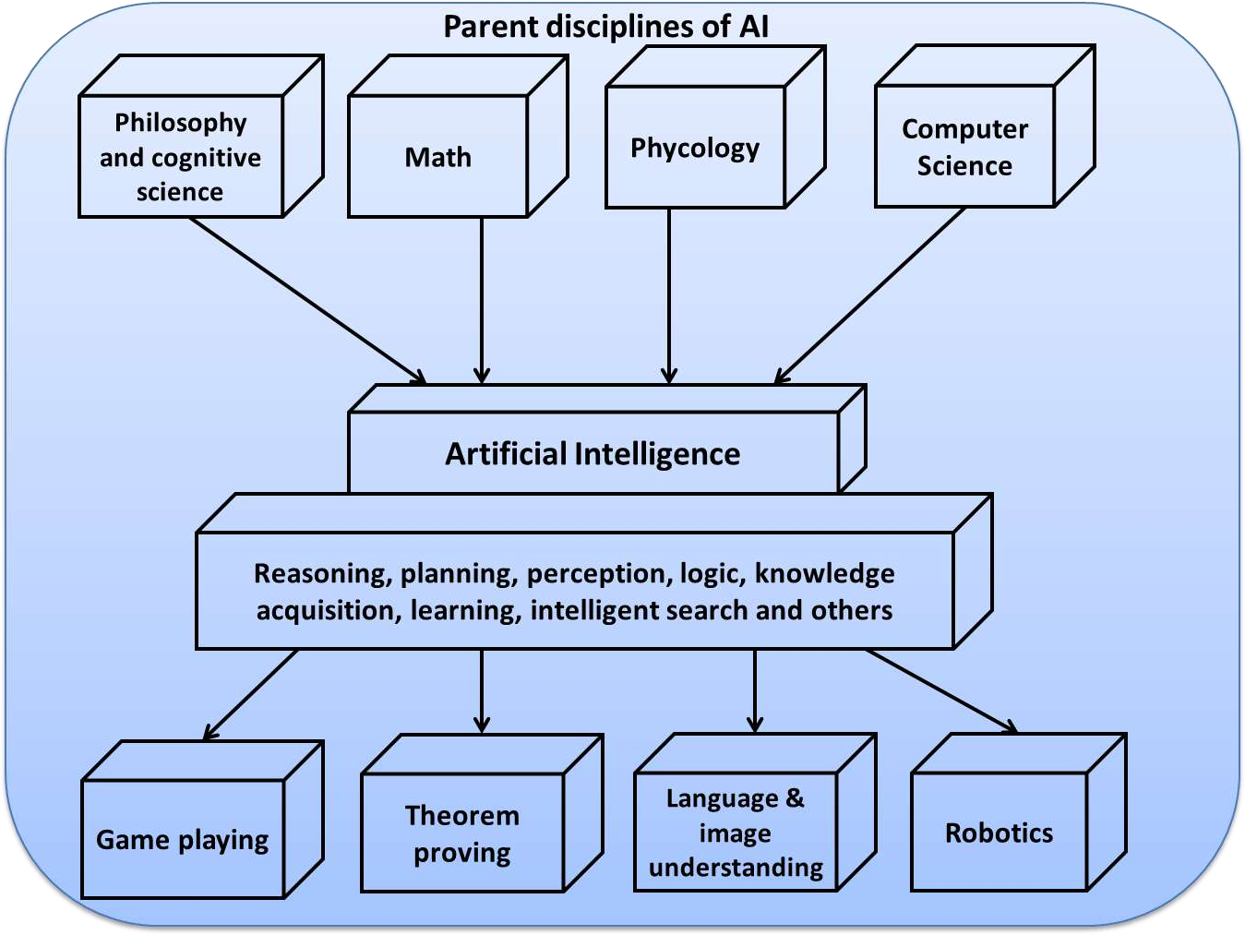

Slide 15
UNIT: 2 Problems, State Space Search & Heuristic Search Techniques

Slide 16
WHAT IS PROBLEM SOLVING?
Problem solving is the major area of concern in Artificial Intelligence.
It is the process of generating solution from given observed data.
To solve a particular problem, we need to build a system or a method which can generate required solution.

Slide 17
Following four things are required for building such system.
1. Define the problem precisely.
This definition must precisely specify the initial situation (input).
What final situation (output) will constitute the acceptable solution to the problem.
2. Analyze the problem.
To identify those important features which can have an immense impact on the appropriateness of various possible techniques for solving the problem.
3. Isolate and represent the task knowledge that is necessary to solve the problem.
4. Choose the best problem solving technique and apply it to the particular problem.

Slide 18
Defining the Problem as a State Space Search
Defining Problem & Search
A problem is described formally as:
Define a state space that contains all the possible configurations of relevant objects.
Specify one or more states within that space that describe possible situations from which the problem solving process may start. These states are called initial states.
Specify one or more states that would be acceptable as solutions to the problem. These states are called goal states.
Specify a set of rules that describe the actions available.

Slide 19
The problem can then be solved by using the rules, in combination with an appropriate control strategy, to move through the problem space until a path from an initial state to a goal state is found.
This process is known as search.
Search is fundamental to the problem-solving process.
Search is a general mechanism that can be used when more direct method is not known.
Search also provides the framework into which more direct methods for solving subparts of a problem can be embedded.

Slide 20
Defining the Problem as a State Space Search
Defining State & State Space
A state is a representation of problem elements at a given moment.
A State space is the set of all states reachable from the initial state.
A state space forms a graph in which the nodes are states and the arcs between nodes are actions.
In state space, a path is a sequence of states connected by a sequence of actions.
The solution of a problem is part of the graph formed by the state space.

Slide 21
The state space representation forms the basis of most of the AI methods.
Its structure corresponds to the structure of problem solving in two important ways:
It allows for a formal definition of a problem as per the need to convert some given situation into some desired situation using a set of permissible operations.
It permits the problem to be solved with the help of known techniques and control strategies to move through the problem space until goal state is found.

Slide 22
Define the Problem as State Space Search
Ex.1:- Consider the problem of Playing Chess
To build a program that could play chess, we have to specify:
The starting position of the chess board,
The rules that define legal moves, and
The board position that represents a win.
The starting position can be described by an 8 X 8 array square in which each element square (x, y), (x varying from 1 to 8 & y varying from 1 to 8) describes the board position of an appropriate piece in the official chess opening position.

Slide 23
The goal is any board position in which the opponent does not have a legal move and his or her “king” is under attack.
The legal moves provide the way of getting from initial state of final state.
The legal moves can be described as a set of rules consisting of two parts: A left side that gives the current position and the right side that describes the change to be made to the board position.
An example is shown in the following figure.

Slide 24
Current Position
While pawn at square ( 5 , 2), AND Square ( 5 , 3 ) is empty, AND Square ( 5 , 4) is empty.
Changing Board Position
Move pawn from Square ( 5 , 2 ) to Square ( 5 , 4 ) .
The current position of a chess coin on the board is its state and the set of all possible states is state space.
One or more states where the problem terminates are goal states.
Chess has approximately 10120 game paths. These positions comprise the problem search space.
Using above formulation, the problem of playing chess is defined as a problem of moving around in a state space, where each state corresponds to a legal position of the board.
State space representation seems natural for play chess problem because the set of states, which corresponds to the set of board positions, is well organized.

Slide 25
Ex.2:- Consider Water Jug problem
A Water Jug Problem: You are given two jugs, a 4-gallon one and a 3-gallon one, a pump which has unlimited water which you can use to fill the jug, and the ground on which water may be poured. Neither jug has any measuring markings on it. How can you get exactly 2 gallons of water in the 4-gallon jug?
Here the initial state is (0, 0). The goal state is (2, n) for any value of n.
State Space Representation: we will represent a state of the problem as a tuple (x, y) where x represents the amount of water in the 4-gallon jug and y represents the amount of water in the 3-gallon jug. Note that 0 ≤ x ≤ 4, and 0 ≤ y ≤ 3.

Slide 26
To solve this we have to make some assumptions not mentioned in the problem. They are:
We can fill a jug from the pump.
We can pour water out of a jug to the ground.
We can pour water from one jug to another.
There is no measuring device available.
Operators – we must define a set of operators that will take us from one state to another.

Slide 27
Sr. | Current state | Next State | Descriptions
1 | (x, y) if x < 4 | (4,y) | Fill the 4 gallon jug
2 | (x, y) if y <3 | (x,3) | Fill the 3 gallon jug
3 | (x, y) if x > 0 | (x-d, y) | Pour some water out of the 4 gallon jug
4 | (x, y) if y > 0 | (x, y-d) | Pour some water out of the 3 gallon jug
5 | (x, y) if x>0 | (0, y) | Empty the 4 gallon jug
6 | (x, y) if y >0 | (x,0) | Empty the 3 gallon jug on the ground
7 | (x, y) if x+y >= 4 and y > 0 | (4, y-(4-x)) | Pour water from the 3 gallon jug into the 4 gallon jug until the 4 gallon jug is full
8 | (x, y) if x+y >= 3 and x>0 | (x-(3-y), 3) | Pour water from the 4 gallon jug into the 3-gallon jug until the 3 gallon jug is full
9 | (x, y) if x+y <=4 and y>0 | (x+y, 0) | Pour all the water from the 3 gallon jug into the 4 gallon jug

Slide 28
10 | (x, y) if x+y <= 3 and x>0 | (0, x+y) | Pour all the water from the 4 gallon jug into the 3 gallon jug
11 | (0,2) | (2,0) | Pour the 2 gallons from 3 gallon jug into the 4 gallon jug
12 | (2,y) | (0,y) | Empty the 2 gallons in the 4 gallon jug on the ground

Slide 29
There are several sequences of operators that will solve the problem.
One of the possible solutions is given as:
Gallons in the 4- gallon jug | Gallons in the 3- gallon jug | Rule applied
0 | 0 | 2
0 | 3 | 9
3 | 0 | 2
3 | 3 | 7
4 | 2 | 5 or 12
0 | 2 | 9 0r 11
2 | 0 | --

Slide 30
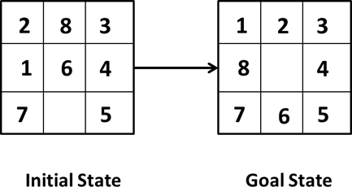
Ex.3:- Consider 8 puzzle problem
The 8 puzzle consists of eight numbered, movable tiles set in a 3x3 frame. One cell of the frame is always empty thus making it possible to move an adjacent numbered tile into the empty cell. Such a puzzle is illustrated in following diagram.
The program is to change the initial configuration into the goal configuration.
A solution to the problem is an appropriate sequence of moves, such as “move tiles 5 to
the right, move tile 7 to the left ,move tile 6 to the down” etc…

Slide 31
To solve a problem, we must specify the global database, the rules, and the control strategy.
For the 8 puzzle problem that correspond to three components.
These elements are the problem states, moves and goal.
In this problem each tile configuration is a state.
The set of all possible configuration in the problem space, consists of 3,62,880 different configurations of the 8 tiles and blank space.
For the 8-puzzle, a straight forward description is a 3X3 array of matrix of numbers. Initial global database is this description of the initial problem state. Virtually any kind of data structure can be used to describe states.
A move transforms one problem state into another state

Slide 32
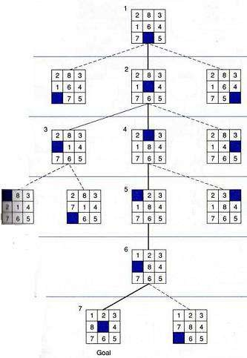
SOLUTION OF 8 PUZZLE PROBLEM

Slide 33
The 8-puzzle is conveniently interpreted as having the following for moves.
Move empty space (blank) to the left, move blank up, move blank to the right and move blank down.
These moves are modeled by production rules that operate on the state descriptions in the appropriate manner.
The goal condition forms the basis for the termination.
The control strategy repeatedly applies rules to state descriptions until a description of a goal state is produced.
It also keeps track of rules that have been applied so that it can compose them into sequence representing the problem solution.
A solution to the 8-puzzle problem is given.

Slide 34
Production System
Search process forms the core of many intelligence processes.
So, it is useful to structure AI programs in a way that facilitates describing and performing the search process.
Production system provides such structures.

Slide 35
A production system consists of:
A set of rules, each consisting of a left side that determines the applicability of the rule and a right side that describes the operation to be performed if that rule is applied.
One or more knowledge/databases that contain whatever information is appropriate for the particular task. Some parts of the database may be permanent, while other parts of it may pertain only to the solution of the current problem.
A control strategy that specifies the order in which the rules will be compared to the database and a way of resolving the conflicts that arise when several rules match at once.
A rule applier which is the computational system that implements the control strategy and applies the rules.

Slide 36
• In order to solve a problem:
o We must first reduce it to the form for which a precise statement can be given. This can be done by defining the problem’s state space (start and goal states) and a set of operators for moving that space.
o The problem can then be solved by searching for a path through the space from an initial state to a goal state.
o The process of solving the problem can usefully be modeled as a production system.

Slide 37
Benefits of Production System
Production systems provide an excellent tool for structuring AI programs.
Production Systems are highly modular because the individual rules can be added, removed or modified independently.
The production rules are expressed in a natural form, so the statements contained in the knowledge base should be easily understandable.

Slide 38
Production System Characteristics
Monotonic Production System: the application of a rule never prevents the later application of another rule that could also have been applied at the time the first rule was selected. i.e., rules are independent.
Non-Monotonic Production system is one in which this is not true.
Partially commutative Production system: a production system with the property that if application of a particular sequence of rules transforms state x to state y, then allowable permutation of those rules, also transforms state x into state y.
Commutative Production system: A Commutative production system is a production system that is both monotonic and partially commutative.

Slide 39
Control Strategies
Control strategies help us decide which rule to apply next during the process of searching for a solution to a problem.
Good control strategy should:
It should cause motion
It should be Systematic

Slide 40
Control strategies are classified as:
Uninformed/blind search control strategy:
Do not have additional information about states beyond problem definition.
Total search space is looked for solution.
Example: Breadth First Search (BFS), Depth First Search (DFS), Depth Limited Search (DLS).
Informed/Directed Search Control Strategy:
Some information about problem space is used to compute preference among the various possibilities for exploration and expansion.
Examples: Best First Search, Problem Decomposition, A*, Mean end Analysis

Slide 41
Breadth-First Search Strategy (BFS)
This is an exhaustive search technique.
The search generates all nodes at a particular level before proceeding to the next level of the tree.
The search systematically proceeds testing each node that is reachable from a parent node before it expands to any child of those nodes.
Search terminates when a solution is found and the test returns true.

Slide 42
Algorithm:
Create a variable called NODE-LIST and set it to initial state.
Until a goal state is found or NODE-LIST is empty do:
Remove the first element from NODE-LIST and call it E. If NODE-LIST was empty, quit.
For each way that each rule can match the state described in E do:
Apply the rule to generate a new state.
If the new state is a goal state, quit and return this state.
Otherwise, add the new state to the end of NODE-LIST.

Slide 43
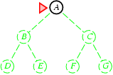
Breadth-first search
Expand shallowest unexpanded node
Implementation:
fringe is a first-in-first-out (FIFO) queue, i.e., new successors go at end of the queue.
Is A a goal state?

Slide 44
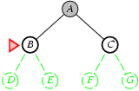
Breadth-first search
Expand shallowest unexpanded node
Implementation:
fringe is a FIFO queue, i.e., new successors go at end
Expand:
fringe = [B,C]
Is B a goal state?

Slide 45
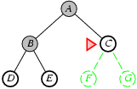
Breadth-first search
Expand shallowest unexpanded node
Implementation:
fringe is a FIFO queue, i.e., new successors go at end
Expand:
fringe=[C,D,E]
Is C a goal state?

Slide 46
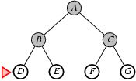
Breadth-first search
Expand shallowest unexpanded node
Implementation:
fringe is a FIFO queue, i.e., new successors go at end
Expand:
fringe=[D,E,F,G]
Is D a goal state?

Slide 47
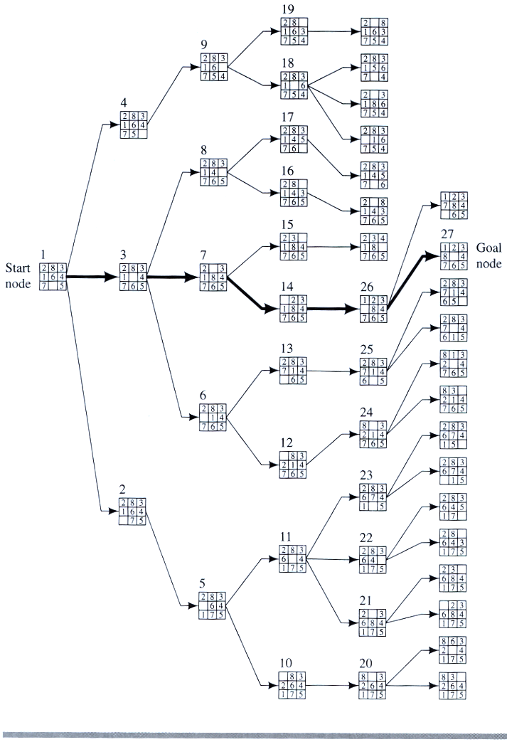
Example
BFS

Slide 48
Depth-First Search Strategy (DFS)
Here, the search systematically proceeds to some depth d, before another path is considered.
If the maximum depth of search tree is reached and if the solution has not been found, then the search backtracks to the previous level and explores any remaining alternatives at this level, and so on.

Slide 49
Algorithm:
If the initial state is a goal state, quit and return success
Otherwise, do the following until success or failure is signaled:
Generate a successor, E, of initial state. If there are no more successors, signal failure.
Call Depth-First Search, with E as the initial state
If success is returned, signal success. Otherwise continue in this loop.

Slide 50
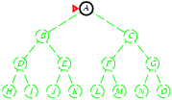
Depth-first search
Expand deepest unexpanded node
Implementation:
fringe = Last In First Out (LIFO) queue, i.e., put successors at front
Is A a goal state?

Slide 51
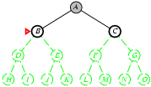
Depth-first search
Expand deepest unexpanded node
Implementation:
fringe = LIFO queue, i.e., put successors at front
queue=[B,C]
Is B a goal state?

Slide 52
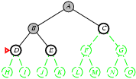
Depth-first search
Expand deepest unexpanded node
Implementation:
fringe = LIFO queue, i.e., put successors at front
queue=[D,E,C]
Is D = goal state?

Slide 53
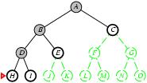
Depth-first search
Expand deepest unexpanded node
Implementation:
fringe = LIFO queue, i.e., put successors at front
queue=[H,I,E,C]
Is H = goal state?

Slide 54
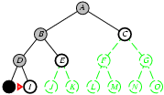
Depth-first search
Expand deepest unexpanded node
Implementation:
fringe = LIFO queue, i.e., put successors at front
queue=[I,E,C]
Is I = goal state?

Slide 55
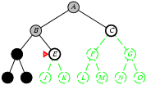
Depth-first search
Expand deepest unexpanded node
Implementation:
fringe = LIFO queue, i.e., put successors at front
queue=[E,C]
Is E = goal state?

Slide 56
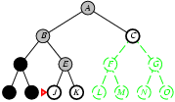
Depth-first search
Expand deepest unexpanded node
Implementation:
fringe = LIFO queue, i.e., put successors at front
queue=[J,K,C]
Is J = goal state?

Slide 57
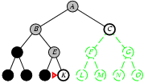
Depth-first search
Expand deepest unexpanded node
Implementation:
fringe = LIFO queue, i.e., put successors at front
queue=[K,C]
Is K = goal state?

Slide 58
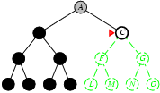
Depth-first search
Expand deepest unexpanded node
Implementation:
fringe = LIFO queue, i.e., put successors at front
queue=[C]
Is C = goal state?

Slide 59
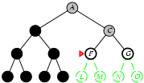
Depth-first search
Expand deepest unexpanded node
Implementation:
fringe = LIFO queue, i.e., put successors at front
queue=[F,G]
Is F = goal state?

Slide 60
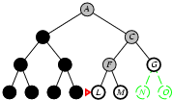
Depth-first search
Expand deepest unexpanded node
Implementation:
fringe = LIFO queue, i.e., put successors at front
queue=[L,M,G]
Is L = goal state?

Slide 61
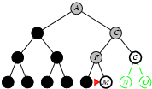
Depth-first search
Expand deepest unexpanded node
Implementation:
fringe = LIFO queue, i.e., put successors at front
queue=[M,G]
Is M = goal state?

Slide 62
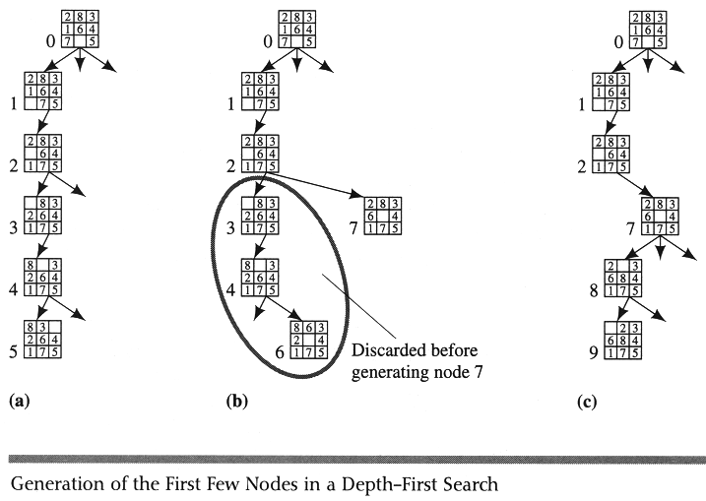
Example DFS

Slide 63
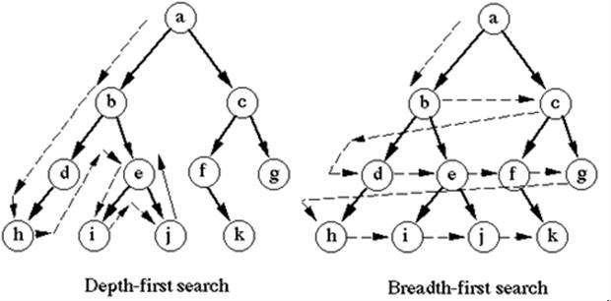
Comparison: DFS & BFS
Depth First Search | Breath First Search
DFS requires less memory since only the nodes on the current path are stored. | BFS guarantees that the space of possible moves is systematically examined; this search requires considerable memory resources.
By chance, DFS may find a solution without examining much of the search space at all. Then it finds solution faster. | The search systematically proceeds testing each node that is reachable from a parent node before it expands to any child of those nodes.
If the selected path does not reach to the solution node, DFS gets stuck into a blind alley. | BFS will not get trapped exploring a blind alley.
Does not guarantee to find solution. Backtracking is required if wrong path is selected. | If there is a solution, BFS is guaranteed to find it.

Slide 64
Iterative Deepening Search
Depth first search is incomplete if there is an infinite branch in the search tree.
Infinite branches can happen if:
paths contain loops
infinite number of states and/or operators.
For problems with infinite (or just very large) state spaces, several variants of depth-first search have been developed:
depth limited search
iterative deepening search

Slide 65
Depth limited search (DLS) is a form of depth-first search.
It expands the search tree depth-first up to a maximum depth 𝑙
The nodes at depth 𝑙 are treated as if they had no successors
If the search reaches a node at depth 𝑙 where the path is not a solution, we backtrack to the next choice point at 𝑑𝑒𝑝𝑡ℎ < 𝑙
Depth-first search can be viewed as a special case of DLS with 𝑙 = ∞

Slide 66
The depth bound can sometimes be chosen based on knowledge of the problem
For e.g., in the route planning problem, the longest route has length 𝑠 – 1, where 𝑠 is the number of cities (states), so we can set 𝑙 = 𝑠 – 1
For the most problems, 𝑑 is unknown.
Iterative deepening (depth-first) search (IDS) is a form of depth limited search which progressively increases the bound.
It first tries 𝑙 = 1, then 𝑙 = 2, then 𝑙 = 3, etc. until a solution is found

Slide 67
Solution will be found when 𝑙 = 𝑑
IDDFS combines depth-first search’s space-efficiency and breadth-first search’s fast search
(for nodes closer to root).
IDDFS calls DFS for different depths starting from an initial value. In every call, DFS is restricted from going beyond given depth. So basically we do DFS in a BFS fashion.
The example of Iterative-deepening depth-first search as given below, with the current depth-limit (𝑙) starting at 1 and incrementing each time:

Slide 68
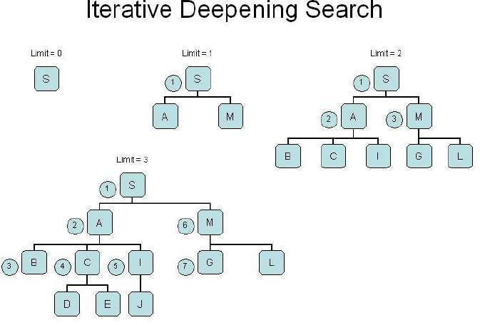

Slide 69
Iterative deepening search
To avoid the infinite depth problem of DFS, we can
decide to only search until depth L, i.e. we don’t expand beyond depth L.
→ Depth-Limited Search
What of solution is deeper than L? → Increase L iteratively.
→ Iterative Deepening Search
As we shall see: this inherits the memory advantage of Depth-First
search.

Slide 70
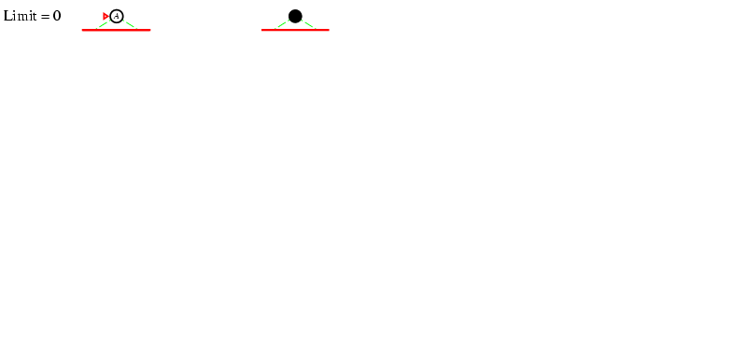
Iterative deepening search L=0

Slide 71
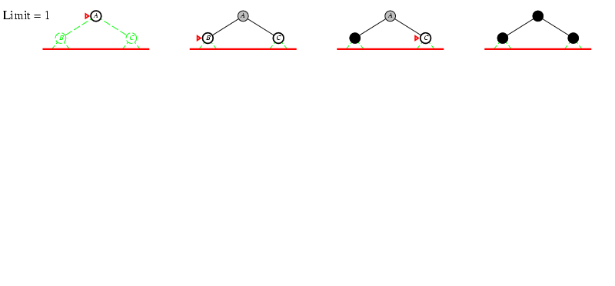
Iterative deepening search L=1

Slide 72
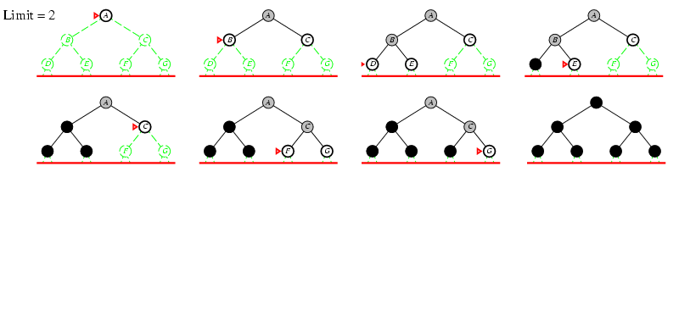
Iterative deepening search lL=2

Slide 73
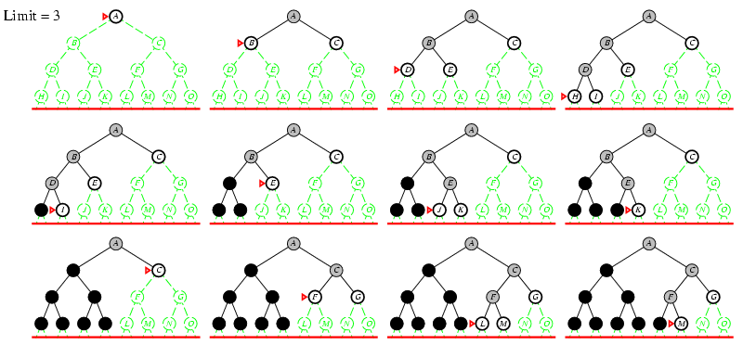
Iterative deepening search lL=3

Slide 74
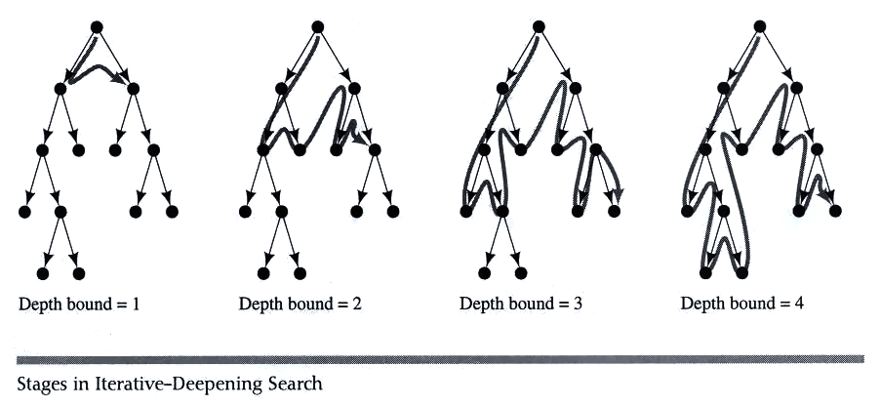
Example IDS

Slide 75
Problem Characteristics
•In order to choose the most appropriate problem solving method, it is necessary to analyze the problem along various key dimensions.
•These dimensions are referred to as problem characteristics discussed below.
1.Is the problem decomposable into a set of independent smaller or easier sub-problems?
A very large and composite problem can be easily solved if it can be broken into smaller problems and recursion could be used.
For example, we want to solve :- ∫ 𝑥2 + 3𝑥 + 𝑠𝑖𝑛2𝑥 𝑐𝑜𝑠2𝑥 𝑑𝑥

Slide 76
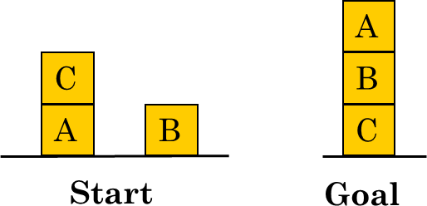
This can be done by breaking it into three smaller problems and solving each by applying specific rules. Adding the results we can find the complete solution.
But there are certain problems which cannot be decomposed into sub-problems.
For example Blocks world problem in which, start and goal state are given as,
Here, solution can be achieved be moving blocks in a sequence such that goal state can be derived.
Solution steps are interdependent and cannot be decomposed in sub problems.
These two examples, symbolic integration and the blocks world illustrate the difference between decomposable and non-decomposable problems.

Slide 77
2. Can solution steps be ignored or at least undone if they prove unwise?
Problem fall under three classes, (i) ignorable, (ii) recoverable and (iii) irrecoverable
This classification is with reference to the steps of the solution to a problem.
Consider theorem proving. We may later find that it is of no use. We can still proceed further, since nothing is lost by this redundant step. This is an example of ignorable solutions steps.
Now consider the 8 puzzle problem tray and arranged in specified order.
While moving from the start state towards goal state, we may make some stupid move but we can backtrack and undo the unwanted move. This only involves additional steps and the solution steps are recoverable.

Slide 78
Lastly consider the game of chess. If a wrong move is made, it can neither be ignored nor be recovered. The thing to do is to make the best use of current situation and proceed. This is an example of an irrecoverable solution steps.
Knowledge of these will help in determining the control structure.
Ignorable problems can be solved using a simple control structure that never backtracks.
Recoverable problems can be solved by a slightly more complicated control strategy that allows backtracking.
Irrecoverable problems will need to be solved by a system that expends a great deal of effort making each decision since decision must be final.

Slide 79
3. Is the problem’s universe predictable?
Problems can be classified into those with certain outcome (eight puzzle and water jug problems) and those with uncertain outcome (playing cards).
In certain – outcome problems, planning could be done to generate a sequence of operators that guarantees to lead to a solution.
Planning helps to avoid unwanted solution steps.
For uncertain outcome problems, planning can at best generate a sequence of operators that has a good probability of leading to a solution.
The uncertain outcome problems do not guarantee a solution and it is often very expensive since the number of solution paths to be explored increases exponentially with the number of points at which the outcome cannot be predicted.
Thus one of the hardest types of problems to solve is the irrecoverable, uncertain –outcome problems (Ex:- Playing cards).

Slide 80
4. Is a good solution to the problem obvious without comparison to all other possible solutions?
There are two categories of problems - Any path problem and Best path problem.
In any path problem, like the water jug and 8 puzzle problems, we are satisfied with the solution, irrespective of the solution path taken.
Whereas in the other category not just any solution is acceptable but we want the best path solution.
Like that of traveling sales man problem, which is the shortest path problem.
In any – path problems, by heuristic methods we obtain a solution and we do not explore alternatives.
Any path problems can often be solved in a reasonable amount of time by using heuristics that suggest good paths to explore.
For the best-path problems all possible paths are explored using an exhaustive search until the best path is obtained.
Best path problems are computationally harder.

Slide 81
5. Is the desired solution a state of the world or a path to a state?
Consider the problem of natural language processing.
Finding a consistent interpretation for the sentence “The bank president ate a dish of pasta salad with the fork”.
We need to find the interpretation but not the record of the processing by which the interpretation is found.
Contrast this with the water jug problem.
In water jug problem, it is not sufficient to report that we have solved, but the path that we found to the state (2, 0). Thus the statement of a solution to this problem must be a sequence of operations that produces the final state.

Slide 82
6.What is the role of knowledge?
Though one could have unlimited computing power, the size of the knowledge base available for solving the problem does matter in arriving at a good solution.
Take for example the game of playing chess, just the rules for determining legal moves and some simple control mechanism is sufficient to arrive at a solution.
But additional knowledge about good strategy and tactics could help to constrain the search and speed up the execution of the program. The solution would then be realistic.
Consider the case of predicting the political trend. This would require an enormous amount of knowledge even to be able to recognize a solution, leave alone the best.

Slide 83
7. Does the task require interaction with a person?
The problems can again be categorized under two heads.
Solitary in which the computer will be given a problem description and will produce an answer, with no intermediate communication and with the demand for an explanation of the reasoning process. Simple theorem proving falls under this category. Given the basic rules and laws, the theorem could be proved, if one exists.
Conversational, in which there will be intermediate communication between a person and the computer, either to provide additional assistance to the computer or to provide additional information to the user, or both, such as medical diagnosis fall under this category, where people will be unwilling to accept the verdict of the program, if they cannot follow its reasoning.

Slide 84
1. Is the problem decomposable into a set of independent smaller or easier sub-problems?
2. Can solution steps be ignored or at least undone if they prove unwise?
3. Is the problem’s universe predictable?
4. Is a good solution to the problem obvious without comparison to all other possible solutions?
5. Is the desired solution a state of the world or a path to a state?
6. What is the role of knowledge?
7. Does the task require interaction with a person?
1.

Slide 85
Problem Classification
Actual problems are examined from the point of view of all these questions; it becomes apparent that there are several broad classes into which the problems fall.

Slide 86
Issues in the design of search programs
The direction in which to conduct the search (forward versus backward reasoning). If the search proceeds from start state towards a goal state, it is a forward search or we can also search from the goal.
How to select applicable rules (Matching). Production systems typically spend most of their time looking for rules to apply. So, it is critical to have efficient procedures for matching rules against states.
How to represent each node of the search process (knowledge representation problem).

Slide 87
Heuristic Search Techniques
In order to solve many hard problems efficiently, it is often necessary to compromise the requirements of mobility and systematicity and to construct a control structure that is no longer guaranteed to find the best answer but will always find a very good answer.
Usually very hard problems tend to have very large search spaces. Heuristics can be used to limit search process.
There are good general purpose heuristics that are useful in a wide variety of problem domains.
Special purpose heuristics exploit domain specific knowledge.

Slide 88
For example nearest neighbor heuristics for shortest path problem. It works by selecting locally superior alternative at each step.
Applying nearest neighbor heuristics to Travelling Salesman Problem:
Arbitrarily select a starting city
To select the next city, look at all cities not yet visited and select the one closest to the current city. Go to next step.
Repeat step 2 until all cities have been visited.
This procedure executes in time proportional to N2, where N is the number of cities to be visited.

Slide 89
Heuristic Function
Heuristic function maps from problem state descriptions to measures of desirability, usually represented as numbers.
Which aspects of the problem state are considered, how those aspects are evaluated, and the weights given to individual aspects are chosen in such a way that the value of the heuristic function at a given node in the search process gives as good an estimate as possible of whether that node is on the desired path to a solution.
Well-designed heuristic functions can play an important part in efficiently guiding a search process toward a solution.
Every search process can be viewed as a traversal of a directed graph, in which the nodes represent problem states and the arcs represent relationships between states.

Slide 90
The search process must find a path through this graph, starting at an initial state and ending in one or more final states.
Domain-specific knowledge must be added to improve search efficiency. Information about the problem includes the nature of states, cost of transforming from one state to another, and characteristics of the goals.
This information can often be expressed in the form of heuristic evaluation function.
In general, heuristic search improve the quality of the path that are exported.
Using good heuristics we can hope to get good solutions to hard problems such as the traveling salesman problem in less than exponential time.

Slide 91
GENERATE-AND-TEST ALGORITHM
Generate-and-test search algorithm is a very simple algorithm that guarantees to find a solution if done systematically and there exists a solution.
ALGORITHM: GENERATE-AND-TEST
1.Generate a possible solution. 2.Test to see if this is the expected solution. 3.If the solution has been found quit else go to step 1.
Potential solutions that need to be generated vary depending on the kinds of problems. For some problems the possible solutions may be particular points in the problem space and for some problems, paths from the start state.

Slide 92
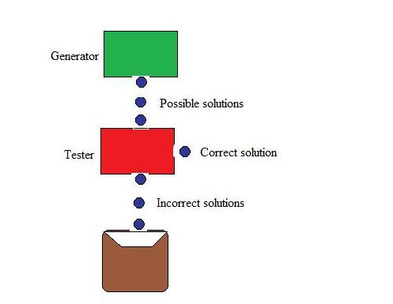

Slide 93
While generating complete solutions and generating random solutions are the two extremes there exists another approach that lies in between. The approach is that the search process proceeds systematically but some paths that unlikely to lead the solution are not considered. This evaluation is performed by a heuristic function.

Slide 94
Hill Climbing
Hill climbing search algorithm is simply a loop that continuously moves in the direction of increasing value. It stops when it reaches a “peak” where no neighbor has higher value. This algorithm is considered to be one of the simplest procedures for implementing heuristic search.
The hill climbing comes from that idea if you are trying to find the top of the hill and you go up direction from where ever you are. This heuristic combines the advantages of both depth first and breadth first searches into a single method.

Slide 95
The name hill climbing is derived from simulating the situation of a person climbing the hill. The person will try to move forward in the direction of at the top of the hill. His movement stops when it reaches at the peak of hill and no peak has higher value of heuristic function than this.
Hill climbing uses knowledge about the local terrain, providing a very useful and effective heuristic for eliminating much of the unproductive search space. It is a branch by a local evaluation function.
The hill climbing is a variant of generate and test in which direction the search should proceed. At each point in the search path, a successor node that appears to reach for exploration.

Slide 96
Algorithm:
Step 1: Evaluate the starting state. If it is a goal state then stop and return success.
Step 2: Else, continue with the starting state as considering it as a current state.
Step 3: Continue step-4 until a solution is found i.e. until there are no new states left to be applied in the current state.
Step 4: a) Select a state that has not been yet applied to the current state and apply it to produce a new state.
b) Procedure to evaluate a new state.
i. If the current state is a goal state, then stop and return success.
ii. If it is better than the current state, then make it current state and proceed further.
iii. If it is not better than the current state, then continue in the loop until a solution is found.
Step 5: Exit.

Slide 97
Additional Problems: Missionaries and Cannibals Problem
Question: In this problem, three missionaries and three cannibals must cross a river using a boat which can carry at most two people, under the constraint that, for both banks, that the missionaries present on the bank cannot be outnumbered by cannibals. The boat cannot cross the river by itself with no people on board.
Solution: First let us consider that both the missionaries (M) and cannibals(C) are on the same side of the river. Left Right Initially the positions are : 0M , 0C and 3M , 3C (B)
Now let’s send 2 Cannibals to left of bank : 0M , 2C (B) and 3M , 1C

Slide 98
Send one cannibal from left to right : 0M , 1C and 3M , 2C (B)
Now send the 2 remaining Cannibals to left : 0M , 3C (B) and 3M , 0C Send 1 cannibal to the right : 0M , 2C and 3M , 1C (B)
Now send 2 missionaries to the left : 2M , 2C (B) and 1M . 1C
Send 1 missionary and 1 cannibal to right : 1M , 1C and 2M , 2C (B)
Send 2 missionaries to left : 3M , 1C (B) and 0M , 2C
Send 1 cannibal to right : 3M , 0C and 0M , 3C (B)
Send 2 cannibals to left : 3M , 2C (B) and 0M , 1C
Send 1 cannibal to right : 3M , 1C and 0M , 2C (B)’
Send 2 cannibals to left : 3M , 3C (B) and 0M , 0C
Here (B) shows the position of the boat after the action is performed. Therefore all the missionaries and cannibals have crossed the river safely.

Slide 99
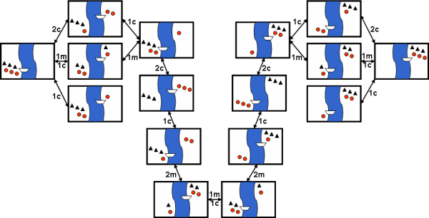

Slide 100
Monkey and Banana Problem
“A monkey is in a room. A bunch of bananas is hanging from the ceiling. The monkey cannot reach then bananas directly. There is a box in the corner of the room. How can the monkey get the bananas?”

Slide 101
The solution of the problem is of course that the monkey must push the box under the bananas, then stand on the box and grab the bananas. But the solution procedure requires a lot of planning algorithms. The purpose of the problem is to raise the question: Are monkeys intelligent? Both humans and monkeys have the ability to use mental maps to remember things like where to go to find shelter or how to avoid danger.
• They can also remember where to go to gather food and water, as well as how to communicate with each other. Monkeys have the ability not only to remember how to hunt and gather but they also have the ability to learn new things, as is the case with the monkey and the bananas. Even though that monkey may never have entered that room before or had only a box for a tool to gather the food available, that monkey can learn that it needs to move the box across the floor, position it below the bananas and climb the box to reach for them. Some people believe that this is part instinct, part learned behaviour. It is most probably both.

Slide 102
Initially, the monkey is at location ‘A’, the banana is at location ‘B’ and the box is at location ‘C’. The monkey and box have height “low”; but if the monkey climbs onto the box will have height “High”, the same as the bananas.
• The action available to the monkey include: “GO” from one place to another. “PUSH” an object from one place to another. “Climb” onto an object. “Grasp” an object.
• Grasping results in holding the object if the monkey and the object are in the same place at the same height.
What is the initial state description?
• At (monkey, A), At (banana, B), At (box, C)
• Position (monkey, low), Position (banana, high), Position (box, low)

Slide 103
What are the definitions of the different actions?
a) Go (x, y) Precondition: At (monkey, x) Effects: ¬At (monkey, x), At (monkey, y)
b) Push (object, x, y, height) Pre condition: At (monkey, x), At (object, x), Position (monkey, height), Position (object, height) Effects: ¬ (monkey, x), ¬At (object, x), At (monkey, y), At(object, y)\
c) Climb up (object, y) Precondition: At (monkey, x), At (object, x), Position (monkey, low), Position (object, low) Effects: ¬Position (monkey, low), Position (monkey, high), On (monkey, object)
d) Climb down (object) Preconditions: Position (monkey, high), On (monkey, object) Effects: ¬Position (monkey, high), ¬ On (monkey, object) Position: (monkey, low)
e) Grasp (object, x, height) Preconditions: At (monkey, x), At (object, x), Position (monkey, height), Position (object, height) Effect: Hold (object)
f) UnGrasp (object, x, height) Preconditions: Hold (object), At (monkey, x), At (object, x), Position (monkey, height), Position (object, height) Effects: ¬Hold (object)

Slide 104
So the solution to the planning problem may be of following steps
1. GO(A,C)
2. PUSH (Box, C, B, Low)
3. Climb Up(Box , B)
4. Grasp(banana, B, High)
5. Climb down(Box)
6. Push(Box, B, C, Low)

Slide 105
Tower of Hanoi Problem
Before getting started, let’s talk about what the Tower of Hanoi problem is. Well, this is a fun puzzle game where the objective is to move an entire stack of disks from the source position to another position. Three simple rules are followed:
Only one disk can be moved at a time.
Each move consists of taking the upper disk from one of the stacks and placing it on top of another stack. In other words, a disk can only be moved if it is the uppermost disk on a stack.
No larger disk may be placed on top of a smaller disk.
Now, let’s try to imagine a scenario. Suppose we have a stack of three disks. Our job is to move this stack from source A to destination C. How do we do this?
Before we can get there, let’s imagine there is an intermediate point B.

Slide 106
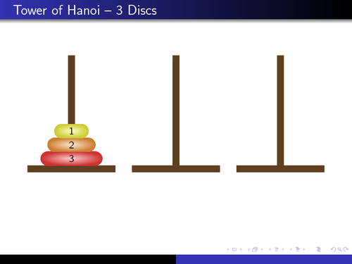

Slide 107

We can use B as a helper to finish this job. We are now ready to move on. Let’s go through each of the steps:
Move the first disk from A to C
Move the first disk from A to B
Move the first disk from C to B
Move the first disk from A to C
Move the first disk from B to A
Move the first disk from B to C
Move the first disk from A to C

Slide 108
Cryptarithmatic Problem
The Crypt-Arithmetic problem in Artificial Intelligence is a type of encryption problem in which the written message in an alphabetical form which is easily readable and understandable is converted into a numeric form which is neither easily readable nor understandable.
In simpler words, the crypt-arithmetic problem deals with the converting of the message from the readable plain text to the non-readable ciphertext. The constraints which this problem follows during the conversion is as follows:
A number 0-9 is assigned to a particular alphabet.
Each different alphabet has a unique number.
All the same, alphabets have the same numbers.
The numbers should satisfy all the operations that any normal number does.

Slide 109
Let us take an example of the message: SEND MORE MONEY.
Here, to convert it into numeric form, we first split each word separately and represent it as follows:
These alphabets then are replaced by numbers such that all the constraints are satisfied. So initially we have all blank spaces.
We first look for the MSB in the last word which is 'M' in the word 'MONEY' here. It is the letter which is generated by carrying. So, carry generated can be only one. SO, we have M=1.
Now, we have S+M=O in the second column from the left side. Here M=1. Therefore, we have, S+1=O. So, we need a number for S such that it generates a carry when added with 1. And such a number is 9. Therefore, we have S=9 and O=0.
S E N D
M O R E
---------
M O N E Y

Slide 110
Now, in the next column from the same side we have E+O=N. Here we have O=0. Which means E+0=N which is not possible. This means a carry was generated by the lower place digits. So we have:
1+E=N ----------(i)
Next alphabets that we have are N+R=E -------(ii)
So, for satisfying both equations (i) and (ii), we get E=5 and N=6.
Now, R should be 9, but 9 is already assigned to S, So, R=8 and we have 1 as a carry which is generated from the lower place digits.
Now, we have D+5=Y and this should generate a carry. Therefore, D should be greater than 4. As 5, 6, 8 and 9 are already assigned, we have D=7 and therefore Y=2.
Therefore, the solution to the given Crypt-Arithmetic problem is:
S=9; E=5; N=6; D=7; M=1; O=0; R=8; Y=2
9 5 6 7
1 0 8 5
------------ 1 0 6 5 2

Slide 111
Best-First Search
DFS is good because it allows a solution to be found without expanding all competing branches. BFS is good because it does not get trapped on dead end paths.
Best first search combines the advantages of both DFS and BFS into a single method.
One way of combining BFS and DFS is to follow a single path at a time, but switch paths whenever some competing path looks more promising than the current one does.
At each step of the Best First Search process; we select the most promising of the nodes we have generated so far.
This is done by applying an appropriate heuristic function to each of them.
We then expand the chosen node by using the rules to generate its successors.
If one of them is a solution, we can quit. If not, all those new nodes are added to the set of nodes generated so far.

Slide 112
OR Graphs
It is sometimes important to search graphs so that duplicate paths will not be pursued.
An algorithm to do this will operate by searching a directed graph in which each node represents a point in problem space.
Each node will contain:
Description of problem state it represents
Indication of how promising it is
Parent link that points back to the best node from which it came
List of nodes that were generated from it
Parent link will make it possible to recover the path to the goal, once the goal is found.
The list of successors will make it possible, if a better path is found to an already existing node, to propagate the improvement down to its successors.
This is called OR-graph, since each of its branches represents an alternative problem solving path.

Slide 113
Implementation of OR graphs
We need two lists of nodes:
OPEN – nodes that have been generated and have had the heuristic function applied to them but which have not yet been examined. OPEN is actually a priority queue in which the elements with the highest priority are those with the most promising value of the heuristic function.
CLOSED- nodes that have already been examined. We need to keep these nodes in memory if we want to search a graph rather than a tree, since whenever a new node is generated; we need to check whether it has been generated before.

Slide 114
Algorithm: Best First Search
Start with OPEN containing just the initial state
Until a goal is found or there are no nodes left on OPEN do:
Pick the best node on OPEN
Generate its successors
For each successor do:
If it has not been generated before, evaluate it, add it to OPEN, and record its parent.
If it has been generated before, change the parent if this new path is better than the previous one. In that case, update the cost of getting to this node and to any successors that this node may already have.

Slide 115
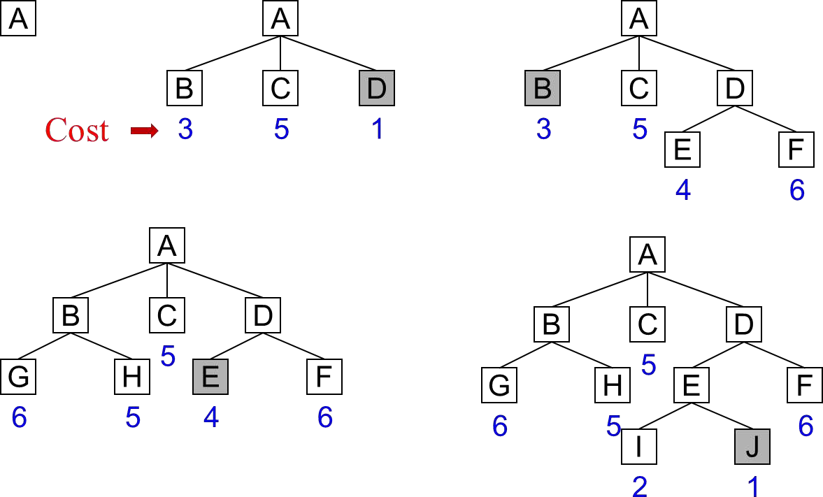
Best First Search example

Slide 116
The A* Algorithm
Best First Search is a simplification of A* Algorithm.
This algorithm uses following functions:
f’: Heuristic function that estimates the merits of each node we generate. f’ = g + h’. f’ represents an estimate of the cost of getting from the initial state to a goal state along with the path that generated the current node.
g: The function g is a measure of the cost of getting from initial state to the current node.
h’: The function h’ is an estimate of the additional cost of getting from the current node to a goal state.
The algorithm also uses the lists: OPEN and CLOSED

Slide 117
Algorithm: A*
Start with OPEN containing only initial node. Set that node’s g value to 0, its h’ value to whatever it is, and its f’ value to h’+0 or h’. Set CLOSED to empty list.
Until a goal node is found, repeat the following procedure: If there are no nodes on OPEN, report failure. Otherwise select the node on OPEN with the lowest f’ value. Call it BESTNODE. Remove it from OPEN. Place it in CLOSED. See if the BESTNODE is a goal state. If so exit and report a solution. Otherwise, generate the successors of BESTNODE but do not set the BESTNODE to point to them yet. For each of the SUCCESSOR, do the following:

Slide 118
Set SUCCESSOR to point back to BESTNODE. These backwards links will make it possible to recover the path once a solution is found.
Compute g(SUCCESSOR) = g(BESTNODE) + the cost of getting from BESTNODE to SUCCESSOR
See if SUCCESSOR is the same as any node on OPEN. If so call the node OLD.
Check whether it is cheaper to get to OLD via its current parent or to SUCESSOR via BESTNODE by comparing their g values.
If OLD is cheaper, then do nothing. If SUCCESSOR is cheaper then reset
OLD’s parent link to point to BESTNODE.
Record the new cheaper path in g(OLD) and update f ‘(OLD).
If SUCCESSOR was not on OPEN, see if it is on CLOSED. If so, call the node on CLOSED OLD and add OLD to the list of BESTNODE’s successors.
If SUCCESSOR was not already on either OPEN or CLOSED, then put it on OPEN and add it to the list of BESTNODE’s successors. Compute f’(SUCCESSOR) = g(SUCCESSOR) + h’(SUCCESSOR).

Slide 119
Observations about A*
Role of g function: This lets us choose which node to expand next on the basis of not only of how good the node itself looks, but also on the basis of how good the path to the node was.
h’, the distance of a node to the goal. If h’ is a perfect estimator of h, then A* will converge immediately to the goal with no search.
Admissibility of A*
A heuristic function h’(n) is said to be admissible if it never overestimates the cost of getting to a goal state.
i.e. if the true minimum cost of getting from node n to a goal state is C then h must satisfy: h’(n) ≤ C
If h’ is a perfect estimator of h, then A* will converge immediately to the goal state with no search.
If h’ never overestimates h, then A* algorithm is guaranteed to find an optimal path if one exists.

Slide 120
Problem Reduction
AND-OR graphs
AND-OR graph (or tree) is useful for representing the solution of problems that can be solved by decomposing them into a set of smaller problems, all of which must then be solved.
This decomposition or reduction generates arcs that we call AND arcs.
One AND arc may point to any numbers of successor nodes. All of which must then be solved in order for the arc to point solution.
In order to find solution in an AND-OR graph we need an algorithm similar to best –first search but with the ability to handle the AND arcs appropriately.
We define FUTILITY, if the estimated cost of solution becomes greater than the value of FUTILITY then we abandon the search, FUTILITY should be chosen to correspond to a threshold.

Slide 121
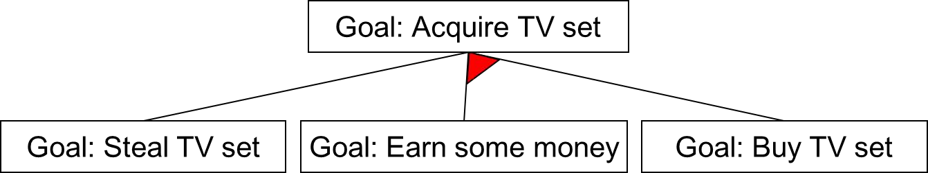
In following figure AND arcs are indicated with a line connecting all the components.

Slide 122
The AO* Algorithm
Rather than the two lists, OPEN and CLOSED, that were used in the A* algorithm, the AO* algorithm will use a single structure GRAPH, representing the part of the search graph that has been explicitly generated so far.
Each node in the graph will point both down to its immediate successors and up to its immediate predecessors.
Each node in the graph will also have associated with it an h' value, an estimate of the cost of a path from itself to a set of solution nodes.
We will not store g (the cost of getting from the start node to the current node) as we did in the A* algorithm.
And such a value is not necessary because of the top-down traversing of the edge
which guarantees that only nodes that are on the best path will ever be considered for expansion.

Slide 123
Algorithm: AO*
Let GRAPH consist only of the node representing the initial state. Call this node INIT, Compute VINIT.
Until INIT is labeled SOLVED or until INIT's h' value becomes greater than FUTILITY, repeat the following procedure:
Trace the labeled arcs from INIT and select for expansion one of the as yet unexpanded nodes that occurs on this path. Call the selected node NODE.
Generate the successors of NODE. If there are none, then assign FUTILITY as the h' value of NODE. This is equivalent to saying that NODE is not solvable. If there are successors, then for each one (called SUCCESSOR) that is not also an ancestor of NODE do the following:
Add SUCCESSOR to GRAPH
If SUCCESSOR is a terminal node, label it SOLVED and assign it an h' value of 0
If SUCCESSOR is not a terminal node, compute its h' value

Slide 124
Propagate the newly discovered information up the graph by doing the following: Let S be a set of nodes that have been labeled SOLVED or whose h' values have been changed and so need to have values propagated back to their parents. Initialize S to NODE. Until S is empty, repeat the, following procedure:
If possible, select from S a node none of whose descendants in GRAPH occurs in S. If there is no such node, select any node from S. Call this node CURRENT, and remove it from S.
Compute the cost of each of the arcs emerging from CURRENT. The cost of each arc is equal to the sum of the h' values of each of the nodes at the end of the arc plus whatever the cost of the arc itself is. Assign as CURRENT'S new h' value the minimum of the costs just computed for the arcs emerging from it.
Mark the best path out of CURRENT by marking the arc that had the minimum cost as computed in the previous step.
Mark CURRENT SOLVED if all of the nodes connected to it through the new labeled arc have been labeled SOLVED.
If CURRENT has been labeled SOLVED or if the cost of CURRENT was just changed, then its new status must be propagated back up the graph. So add all of the ancestors of CURRENT to S.

Slide 125
Constraint Satisfaction
Constraint satisfaction is a search procedure that operates in a space of constraint sets. The initial state contains the constraints that are originally given in the problem description.
A goal state is any state that has been constrained “enough” where “enough” must be defined for each problem.
For example, in cryptarithmetic problems, enough means that each letter has been assigned a unique numeric value.
Constraint Satisfaction problems in AI have goal of discovering some problem state that satisfies a given set of constraints.
Design tasks can be viewed as constraint satisfaction problems in which a design must be created within fixed limits on time, cost, and materials.
Constraint Satisfaction is a two-step process:
First constraints are discovered and propagated as far as possible throughout the system.
Then if there is still not a solution, search begins. A guess about something is made and added as a new constraint.

Slide 126
Algorithm: Constraint Satisfaction
Propagate available constraints. To do this first set OPEN to set of all objects that must have values assigned to them in a complete solution. Then do until an inconsistency is detected or until OPEN is empty:
Select an object OB from OPEN. Strengthen as much as possible the set of constraints that apply to OB.
If this set is different from the set that was assigned the last time OB was examined or if this is the first time OB has been examined, then add to OPEN all objects that share any constraints with OB.
Remove OB from OPEN.
If the union of the constraints discovered above defines a solution, then quit and report the solution.
If the union of the constraints discovered above defines a contradiction, then return the
failure.
If neither of the above occurs, then it is necessary to make a guess at something in order to proceed. To do this loop until a solution is found or all possible solutions have been eliminated:
Select an object whose value is not yet determined and select a way of strengthening the constraints on that object.
Recursively invoke constraint satisfaction with the current set of constraints augmented by strengthening constraint just selected.

Slide 127
Means-Ends Analysis
Collection of strategies presented so far can reason either forward or backward, but for a given problem, one direction or the other must be chosen.
A mixture of the two directions is appropriate. Such a mixed strategy would make it possible to solve the major parts of a problem first and then go back and solve the small problems that arise in “gluing” the big pieces together.
The technique of Means-Ends Analysis (MEA) allows us to do that.
MEA process centers around the detection of differences between the current state and the goal state.
Once such a difference is isolated, an operator that can reduce the difference must be found.
If the operator cannot be applied to the current state, we set up a sub-problem of getting to a state in which it can be applied.
The kind of backward chaining in which operators are selected and then sub-goals are set up to establish the preconditions of the operators is called operator sub-goaling

Slide 128
Algorithm: Means-Ends Analysis
Compare CURRENT to GOAL. If there are no differences between them then return.
Otherwise, select the most important difference and reduce it by doing the following until success or failure is signaled:
Select an as yet untried operator O that is applicable to the current difference. If there are no such operators, then signal failure.
Attempt to apply O to CURRENT. Generate descriptions of two states: O- START, a state in which O’s preconditions are satisfied and O-RESULT, the state that would result if O were applied in O-START.
If
and
(FIRST-PART ß MEA( CURRENT, O-START))
(LAST-PART ß MEA(O-RESULT, GOAL))
are successful, then signal success and return the result of concatenating FIRST-PART, O, and LAST-PART.

